Slide 1
Unit 10
SOURCES OF ENERGY
LESSON 3
A CLOSER LOOK 2

Slide 2
I. GRAMMAR
1. THE FUTURE CONTINUOUS ( THÌ TƯƠNG LAI TIẾP DiỄN)
Diễn tả hành động, sự việc đang xảy ra tại một thời điểm xác định trong tương lai
(+) S + will be + V- ing + …
(- ) S + will not be + V- ing + …
(?) Will + S + be + V-ing + … ?
* Từ nhận biết:
by 2025 (by + năm tương lai)
at 8.00 tomorrow morning
on Sunday this time, next week/ month/ year/ summer, ….

Slide 3
I. GRAMMAR
2. THE SIMPLE FUTURE IN PASIVE FORM. ( THÌ TƯƠNG LAI Ở BỊ ĐỘNG)
(+) S + will be + VPII + …
(- ) S + will not be + VPII + …
(?) Will + S + be + VPII + … ?
* Example
- Solar panels will be put on the roof of the houses.
- The exercises will be finished tomorrow.

Slide 4
II. PRACTICE
1. Complete the sentences, using the future continuous tense. (Ex. 1/ p. 41)
1, will be putting
2, will be taking
3, will be installing
4, will be spending
5, will be using

Slide 5
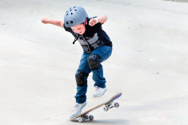
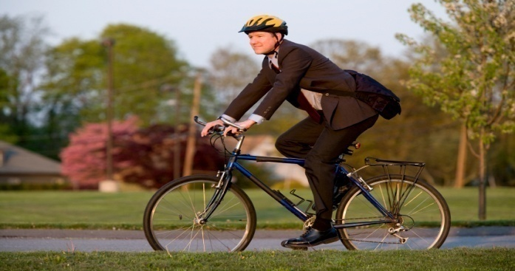
II. PRACTICE
2. Complete the conversation with the verbs in brackets (simple future or future continuous tense). (Ex. 2/ p. 41)
1, will watch
2, will we put
3, will be having
4, will / travel
5, will walk or cycle
6, will be cycling
7, will be going

Slide 6
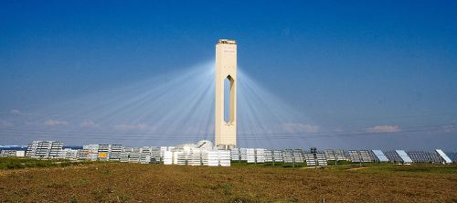
II. PRACTICE
3. Complete the magazine article with the passive form of the verbs below. (Ex. 5/ p. 41)
1, be provided
2. be used
3, be placed
4, be stored
5, be solved

Slide 7
III. FURTHER PRACTICE
1. Write what these students will be doing tomorrow afternoon. (Ex. 2/ p. 41)
2. Change these sentences into the passive voice.
(Ex. 6/ p. 42)
3. Look at the pictures and write what will be done in the future. (Ex. 7/ p. 42)

Slide 8
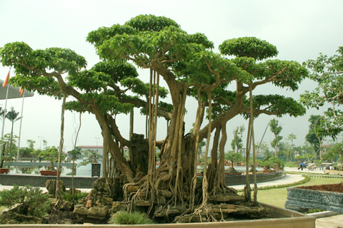
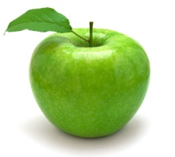
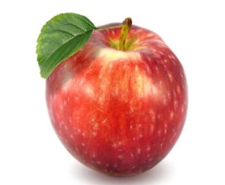
GAME:Lucky red apples
5
7
3
13
11
2
8
1
9
12
14
6
4
10

Slide 9
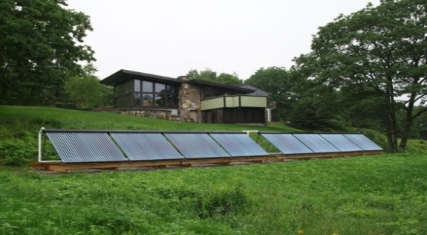
1. Write what these students will be doing tomorrow afternoon. (Ex. 2/ p. 41)
2, Helen /put solar
panels in the playground.
2, Helen will be putting solar panels in the playground.

Slide 10
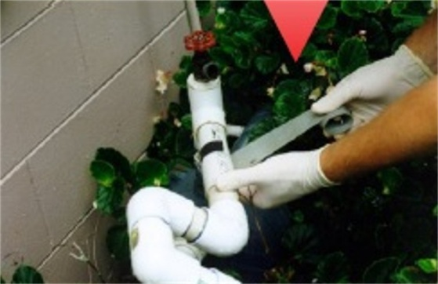
1. Write what these students will be doing tomorrow afternoon. (Ex. 2/ p. 41)
3, Susan /check cracks
in the water pipes.
3, Susan will be checking cracks in the water pipes.

Slide 11
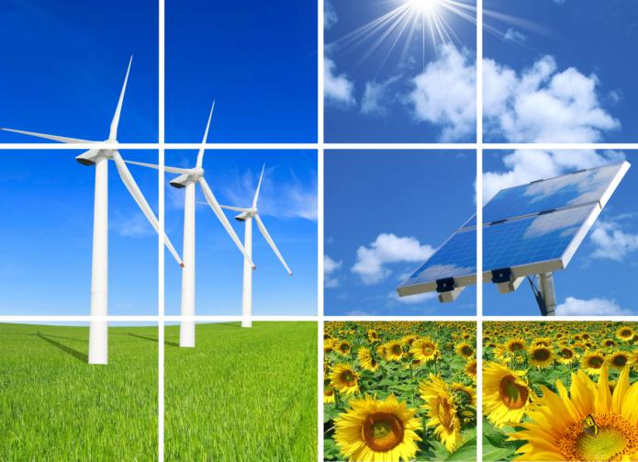
1. Write what these students will be doing tomorrow afternoon. (Ex. 2/ p. 41)
5, Kate /show a film on
types of renewable energy sources.
Kate will be showing a film on types of renewable energy sources.

Slide 12
2. Change these sentences into the passive voice.
(Ex. 6/ p. 41)
1. WE will use WAVES as an environmentally
friendly energy source.
Waves will be used as an environmentally
friendly energy source.
Waves will _______________

Slide 13
2. Change these sentences into the passive voice.
(Ex. 6/ p. 41)
2. They will install A network of wind turbines to make electricity.
A network of wind turbines will be installed to make electricity.
A network of wind turbines will _______________

Slide 14
2. Change these sentences into the passive voice.
(Ex. 6/ p. 41)
3. In the countryside , people will burn plants to
produce heat.
In the countryside , plants will be burnt to
produce heat.
In the countryside , plants will _______________

Slide 15
2. Change these sentences into the passive voice.
(Ex. 6/ p. 41)
5. We will develop Alternative sources of energy.
Alternative sources of energy will be developed.
Alternative sources of energy will _______________

Slide 16
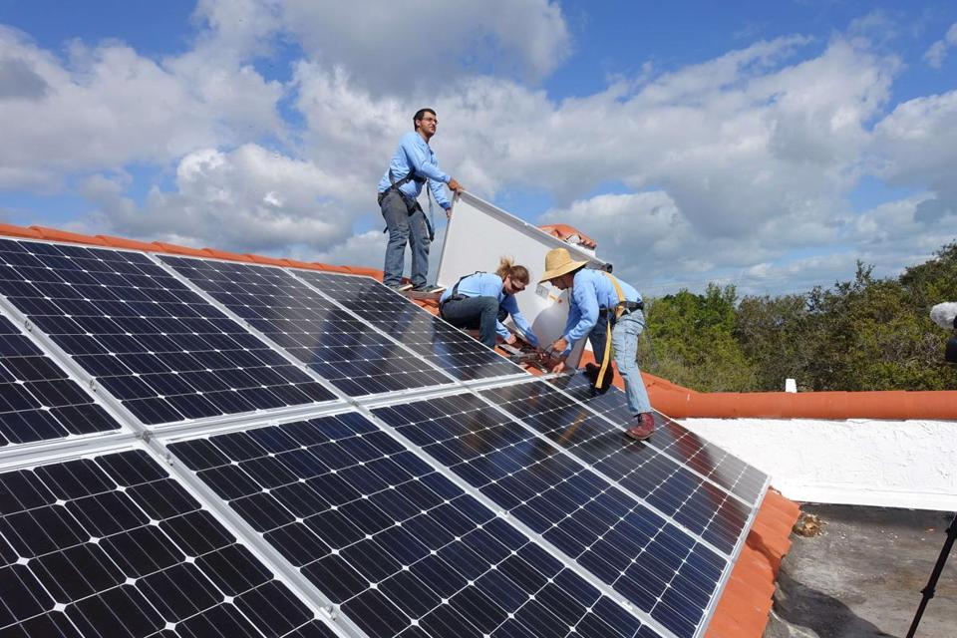
3. Look at the pictures and write what will be done in the future. (Ex. 7/ p. 42)
Solar panels will be put / installed on the roof of the buildings.

Slide 17
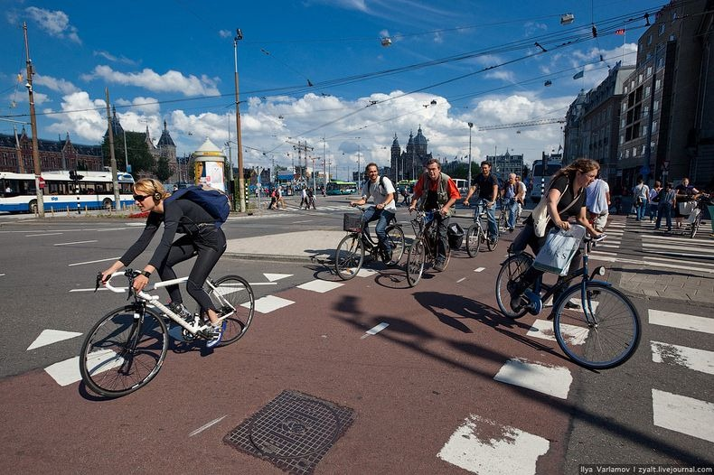
3. Look at the pictures and write what will be done in the future. (Ex. 7/ p. 42)
Bicycles will be used to travel in the city.

Slide 18
AT HOME
Learn all the grammar by heart.
Do all exercises again.
Be ready for COMMUNICATION .

Slide 20
Good bye and see you again!

